Slide 2
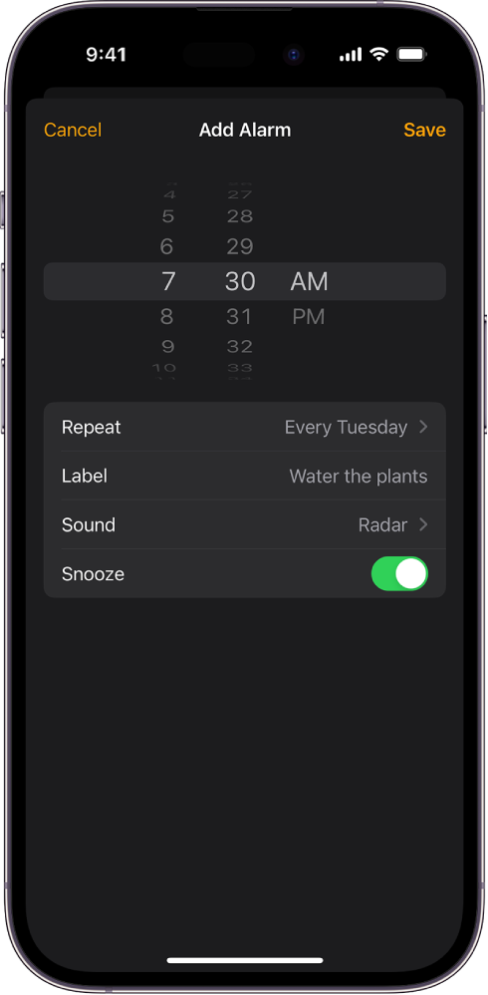
Wifi
Wifi
Wifi
7:45 AM
7:55 AM
8:05 AM
Alarm
Alarm
Alarm
Snooze
Snooze
Snooze

